Slide 1
HND Computing Software Development: Object Oriented Programming (H171 35)
Lecturer – Dawn Wilson

Slide 2
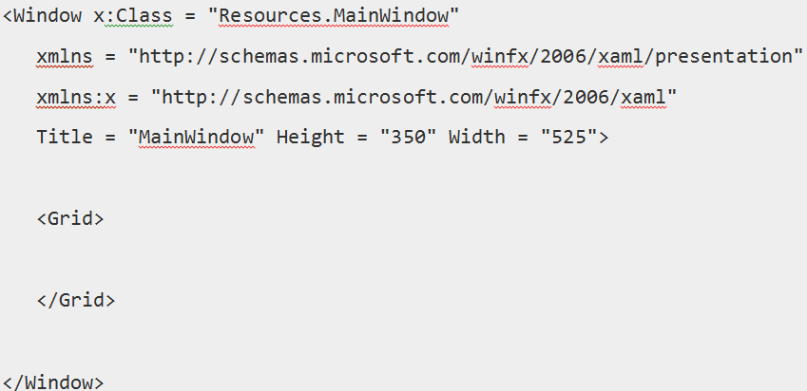
WPF – Basic XAML Syntax
When you create your new WPF project, you will encounter some of the XAML code by default in MainWindow.xaml as shown below.

Slide 3
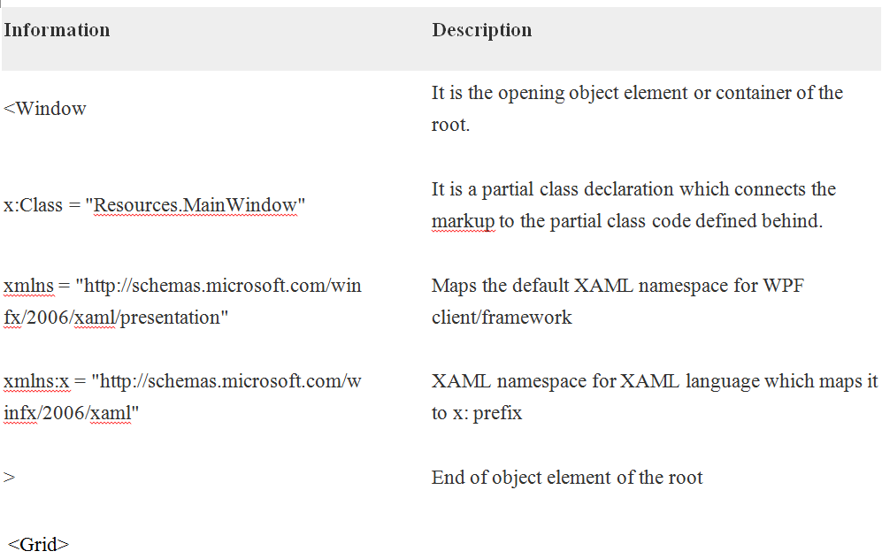
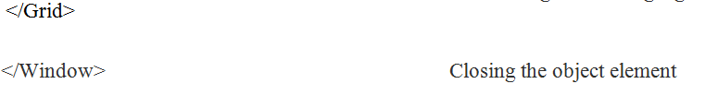
WPF – Basic XAML Syntax
The previous XAML file contains different kinds of information. The following table briefly explains the role of each information:

Slide 4
Building a WPF Window - layout
WPF Windows (and Controls) have a “Content” property that accepts a single control
A Window has a “Content” property that accepts only one control and that should be a “layout control”
WPF layout controls – Grid, StackPanel, DockPanel, WrapPanel and Canvas
The default layout VS creates for a Window is the Grid
Please read the article contained within the document “Overview of WPF Layout Controls” for a comprehensive
explanation

Slide 5
WPF – Basic XAML Syntax
The syntax of an Object element starts with a left angle bracket (<) followed by the name of an object, e.g. Button. Then you can define some Properties and attributes of that object element.
The Object element must be closed by a forward slash (/) followed immediately by a right angle bracket (>).
Object elements can contain attributes, properties, other child elements

Slide 6
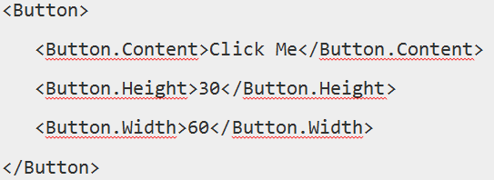
WPF – Basic XAML Syntax
Example of simple object with no child element:
Example of object element with some attributes:
Example of an alternate syntax to define properties (property element syntax):
The period in Button.Content is what distinguishes property elements from object elements. Property elements always take the form TypeName.PropertyName, they are always contained inside a TypeName object element, and they can never have attributes of their own (with one exception—the x:Uid attribute used for localization).

Slide 7
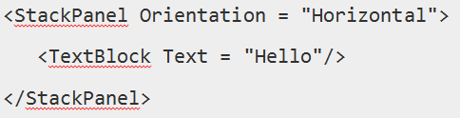
WPF – Basic XAML Syntax
Example of Object with Child Element
StackPanel contains Textblock as child element:

Slide 8
Why XAML in WPF?
XAML is not only the most widely known feature of WPF, but it's also one of the most misunderstood features. Please note these important points:
WPF doesn't need XAML
XAML doesn't need WPF
They are in fact separable pieces of technology

Slide 9
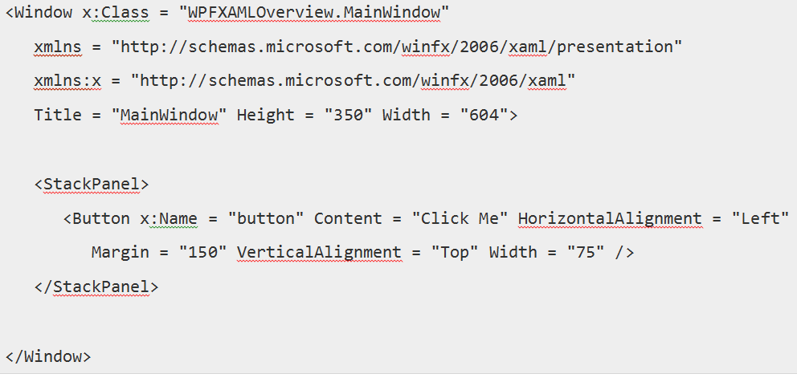
Separable pieces of technology
To understand how that can be, let's look at a simple example in which a button is created with some attributes in XAML.

Slide 10
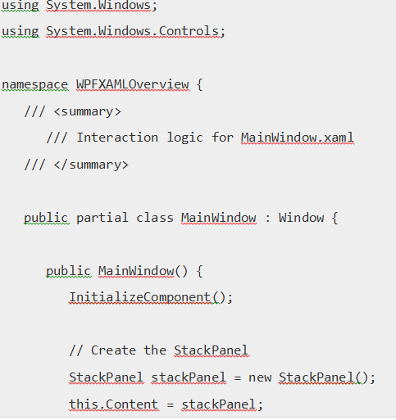
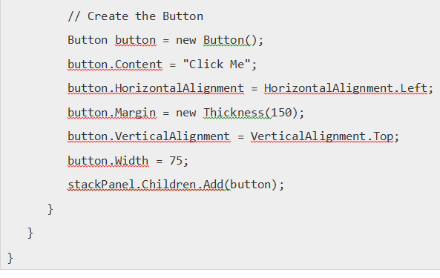
Separable pieces of technology
In case you choose not to use XAML in WPF, then you can achieve the same GUI result by creating a button in C#
Declaring an element (object element) in XAML is equivalent to instantiating the corresponding object via a default constructor in C#
Setting an attribute on the XAML object element is equivalent to setting a property of the same name in C#

Slide 11
Separable pieces of technology
Every element in XAML maps to an instance of .NET class. The name of the element matches the name of the class e.g. <Button instructs WPF to create a Button object

Slide 12
Separable pieces of technology
Setting an event attribute in XAML is equivalent to hooking up an event handler of the same name in C#
XAML:
<Button
Content="Stop" Click="Button_Click"/>
C#:
Windows.UI.Xaml.Controls.Button b = new Windows.UI.Xaml.Controls.Button();
b.Click += new Windows.UI.Xaml.RoutedEventHandler(Button_Click);
b.Content = "Stop";
http://www.informit.com/articles/article.aspx?p=2007361

Slide 13
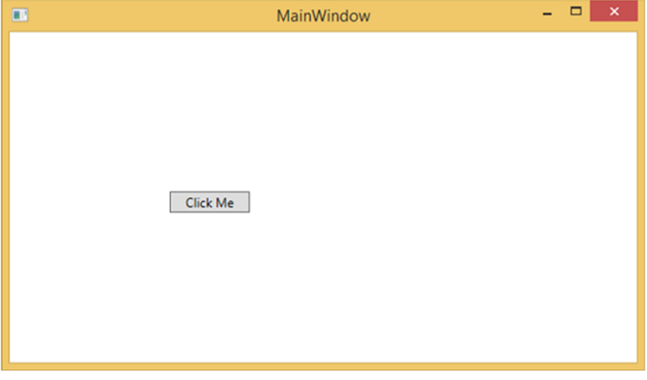
Separable pieces of technology
When you compile and execute either the XAML code or the C# code, you will see the same output as shown below.
From the above example, it is clear that what you can do in XAML to create, initialize, and set properties of objects, the same tasks can also be done using code.
XAML is just another simple and easy way to design UI elements.

Slide 14
Separable pieces of technology
You can either declare the objects in XAML or define them using code.
XAML is optional, but despite this, it is at the heart of WPF design.
The goal of XAML is to enable visual designers to create user interface elements directly.
WPF aims to make it possible to control all visual aspects of the user interface from mark-up.

